Slide 1



Reducing Footskate in Human Motion Reconstruction with Ground Contact Constraints
Yuliang Zou¹ Jimei Yang² Duygu Ceylan² Jianming Zhang² Federico Perazzi² Jia-Bin Huang¹
¹ Virginia Tech ² Adobe Research
Notes:
Hi everyone, this is Yuliang.
Today I am going to present our work, “reducing footskate in human motion reconstruction with ground contact constraints”.

Slide 2
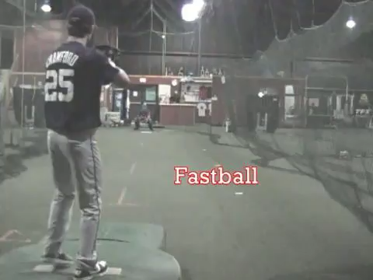
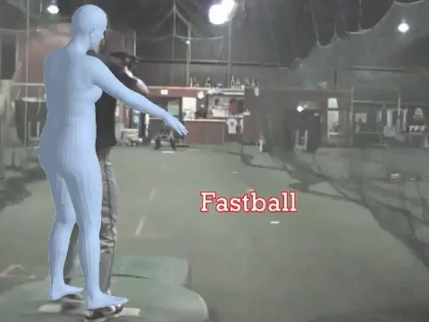
Human Motion Reconstruction
Input: Monocular video
Output: 3D pose/shape estimation
Credit: [Kanazawa et al. CVPR 2017] End-to-end Recovery of Human Shape and Pose
Notes:
Given an input monocular video, we aim to reconstruct the 3D pose and shape for each frame.
This is a fundamental problem in computer vision, and it has a lot of applications.

Slide 3
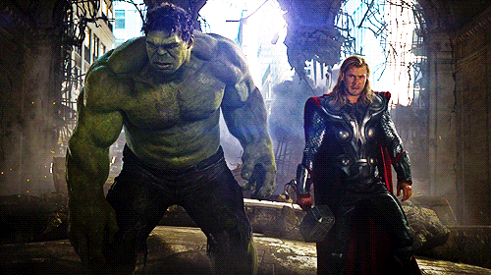
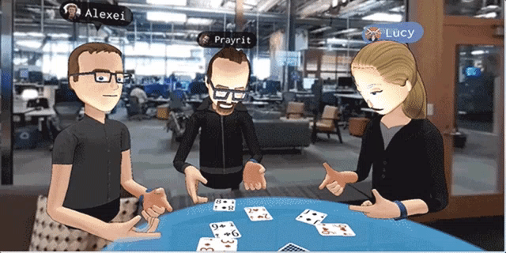
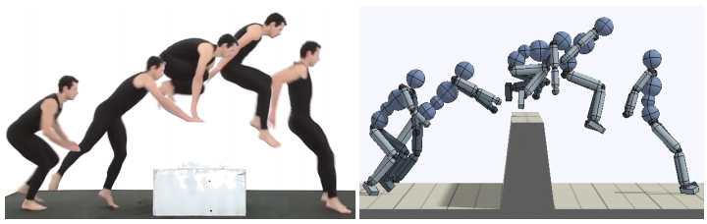
Applications of Human Motion Reconstruction
Character animation
Virtual reality
Robot imitation learning
Notes:
For example, character animation, virtual reality, or robot imitation learning.

Slide 4
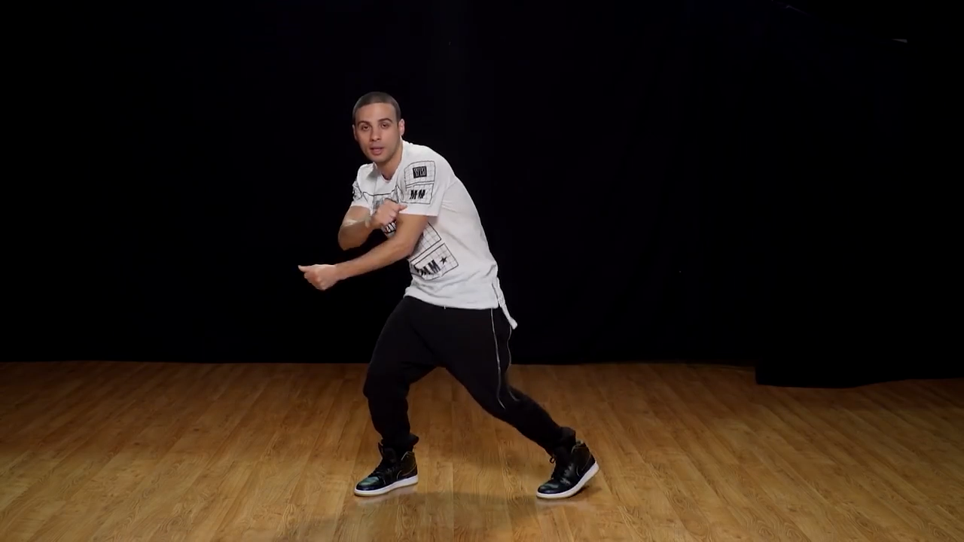
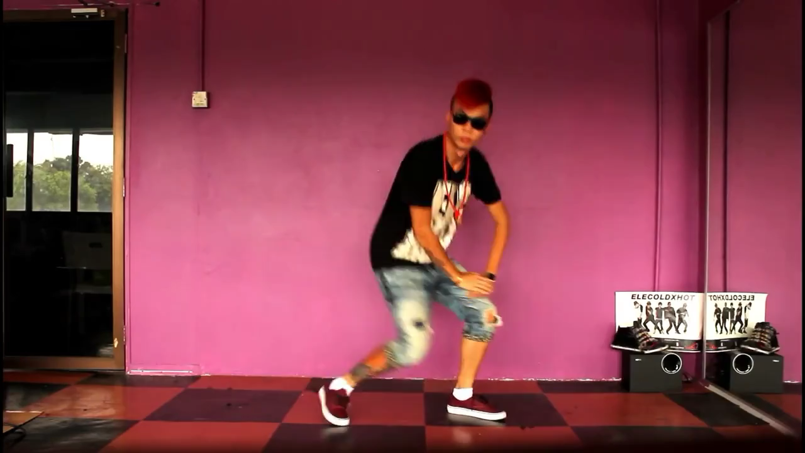
Problems – Footskate
Input: Monocular video
Notes:
Given a monocular video as input

Slide 5
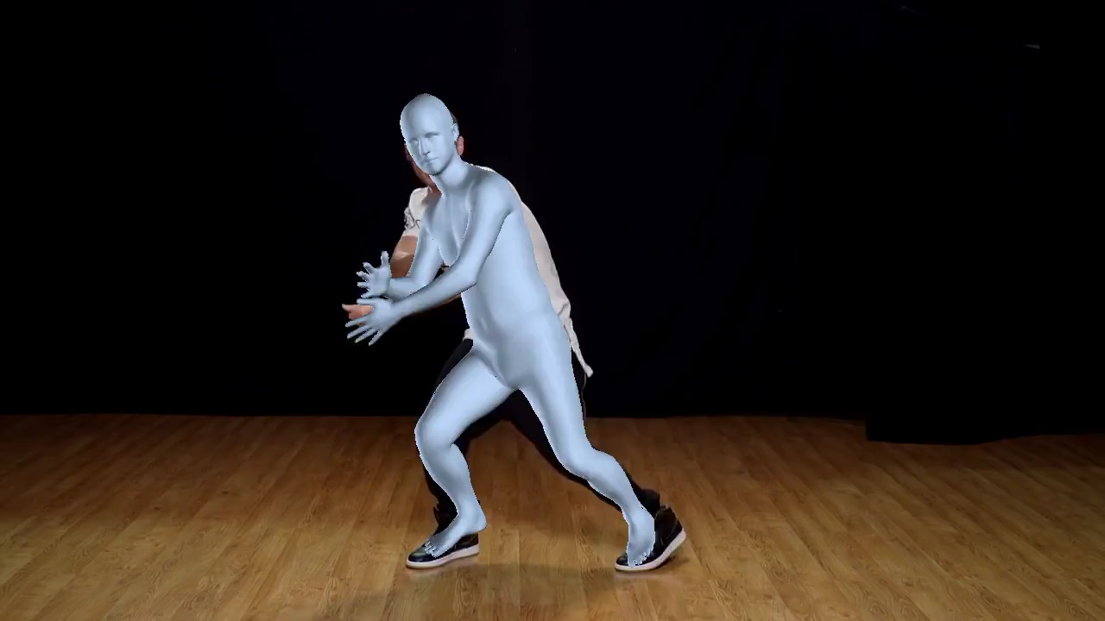
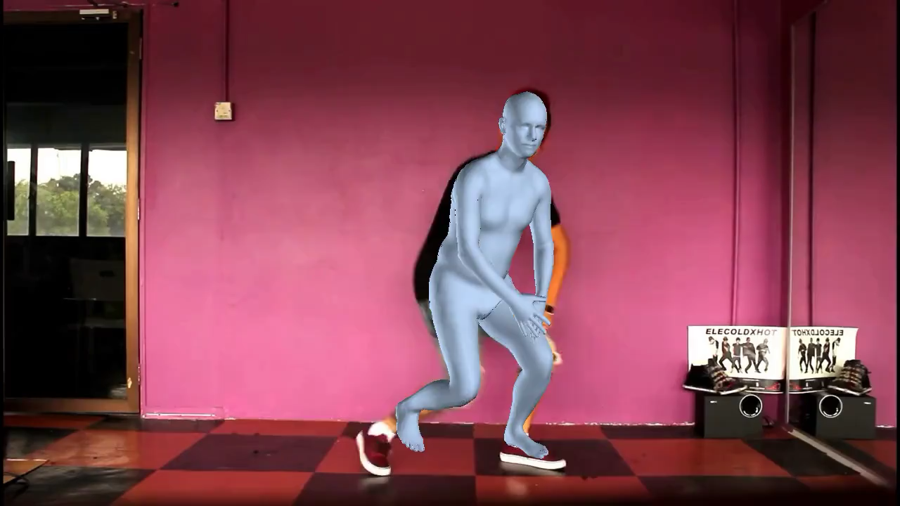
Problems – Footskate
HMR [Kanazawa et al. 2017]
Notes:
The first method is to do estimation on each frame individually.
We can see that the reconstructed motion suffers from high-frequency jittering.

Slide 6

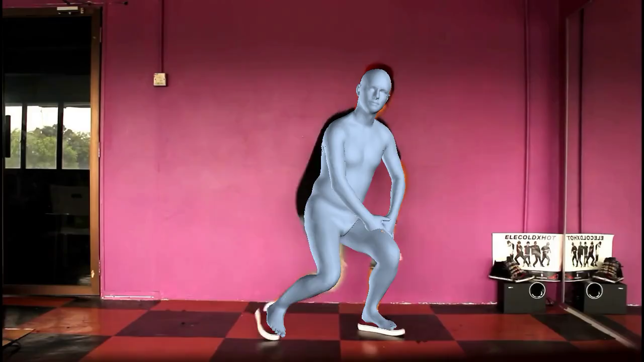
Problems – Footskate
HMR [Kanazawa et al. 2017]
SFV [Peng et al. 2018]
Notes:
The second method adds an additional post processing step on top of single-frame estimation, for temporal smoothing.

Slide 7
Problems – Footskate
SFV [Peng et al. 2018]
Notes:
While it reduces the temporal inconsistency, we can still observe severe foot slippage artifacts when we zoom in, which is called footskate.
This work focuses on reducing such footskate artifacts.

Slide 8
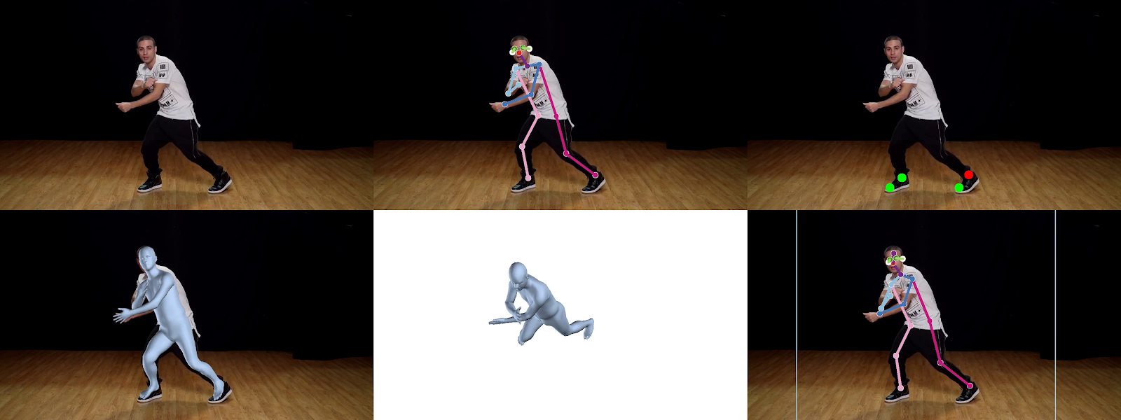
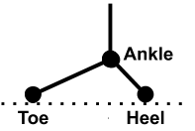
Core Idea
Toes or heals in contact with ground $→$ zero velocity
in contact
not in contact
Foot model
Notes:
Our core idea is that, when the toes or heals are in contact with the ground, the velocity should be zero.
We call it zero-velocity or ground contact constraint.

Slide 9
Pipeline
Notes:
For the whole pipeline
We first extract 2D and 3D poses for each frame individually

Slide 10
Pipeline
Notes:
We then predict ground contact events from the extracted 2D poses, using a deep model

Slide 11
Pipeline
Notes:
After that, we use the zero-velocity constraint for post processing, together with the temporal smoothing constraints.

Slide 12
Step 1: Ground Contact Prediction
Notes:
Now, we are going to talk about ground contact prediction.

Slide 13

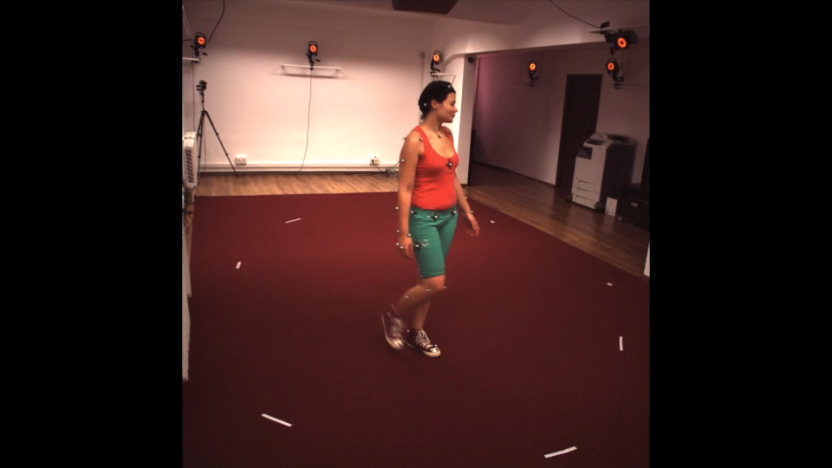
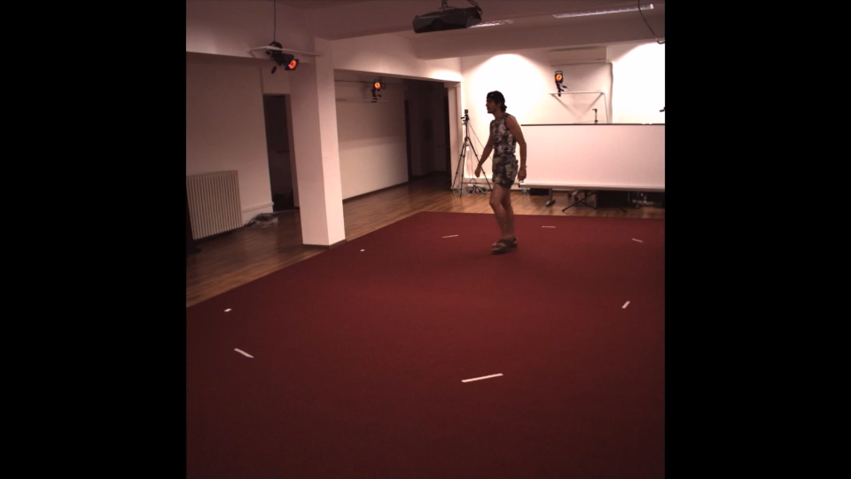
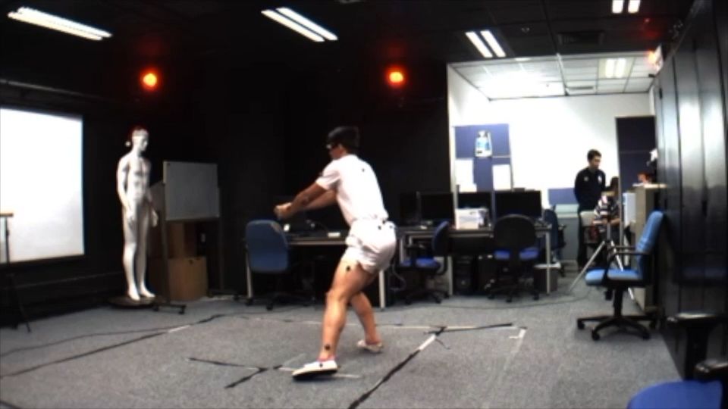
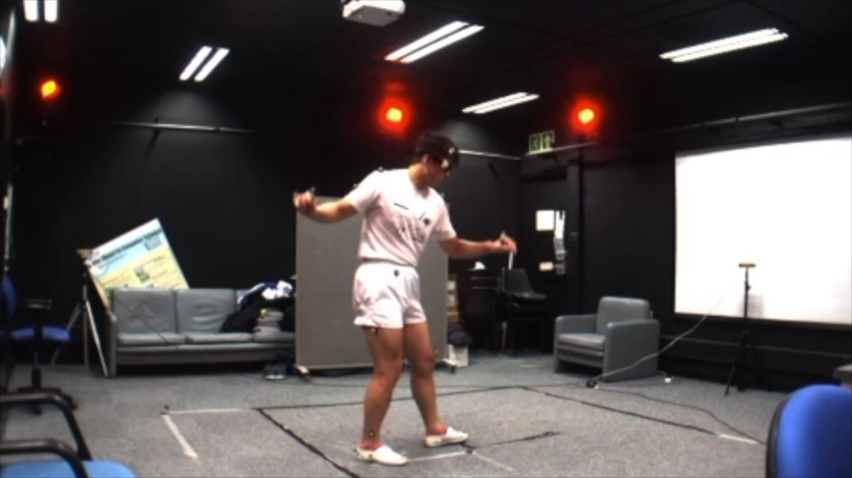
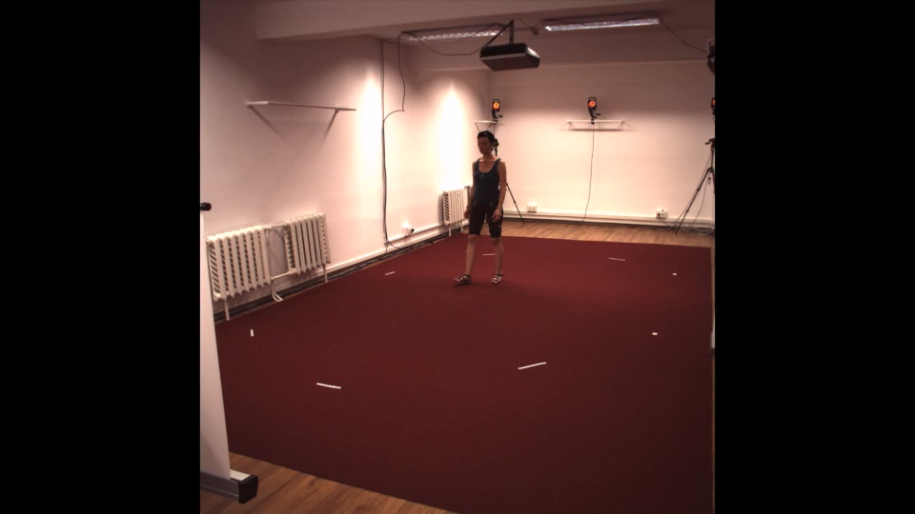
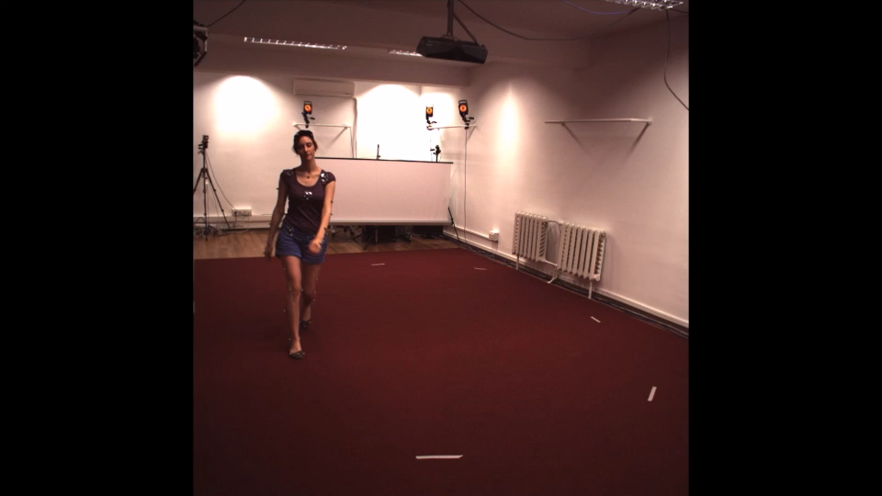
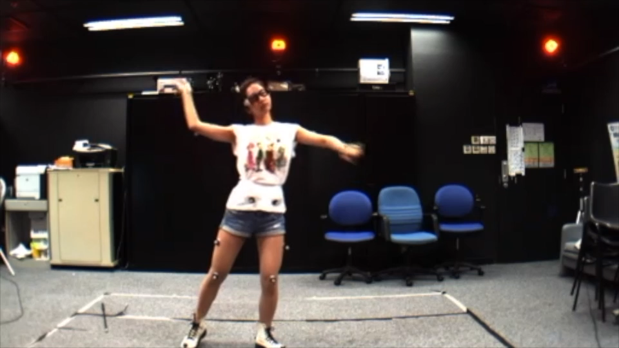
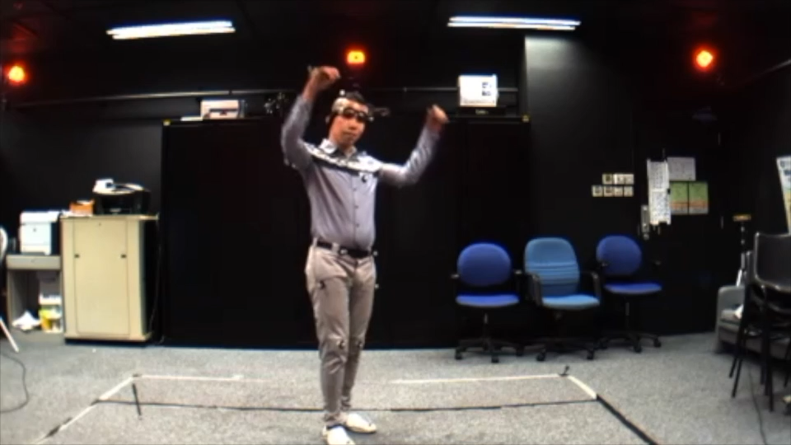
Ground Contact Prediction – Data
No ground contact datasets available
We create a new dataset from Human3.6M and MADS
Credit:
[1] Human3.6M: http://vision.imar.ro/human3.6m/description.php
[2] MADS: http://visal.cs.cityu.edu.hk/research/mads/
Notes:
Since there are no datasets available, we create a new dataset from Human3.6M and MADS.

Slide 14
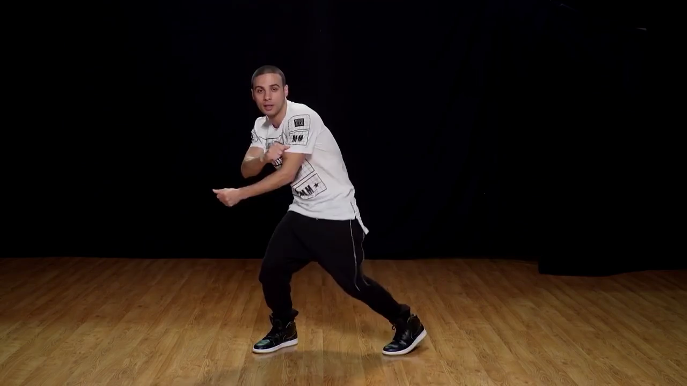
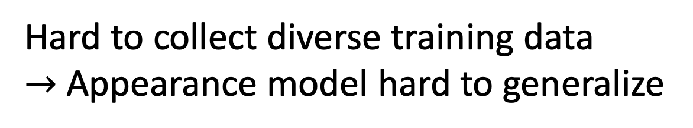
Ground Contact Prediction – Input Representation
Hard to collect diverse training data
$→$ Appearance model hard to generalize
Notes:
For the input representation, since it is hard to collect diverse training data, model trained on RGB frames is hard to generalize.

Slide 15
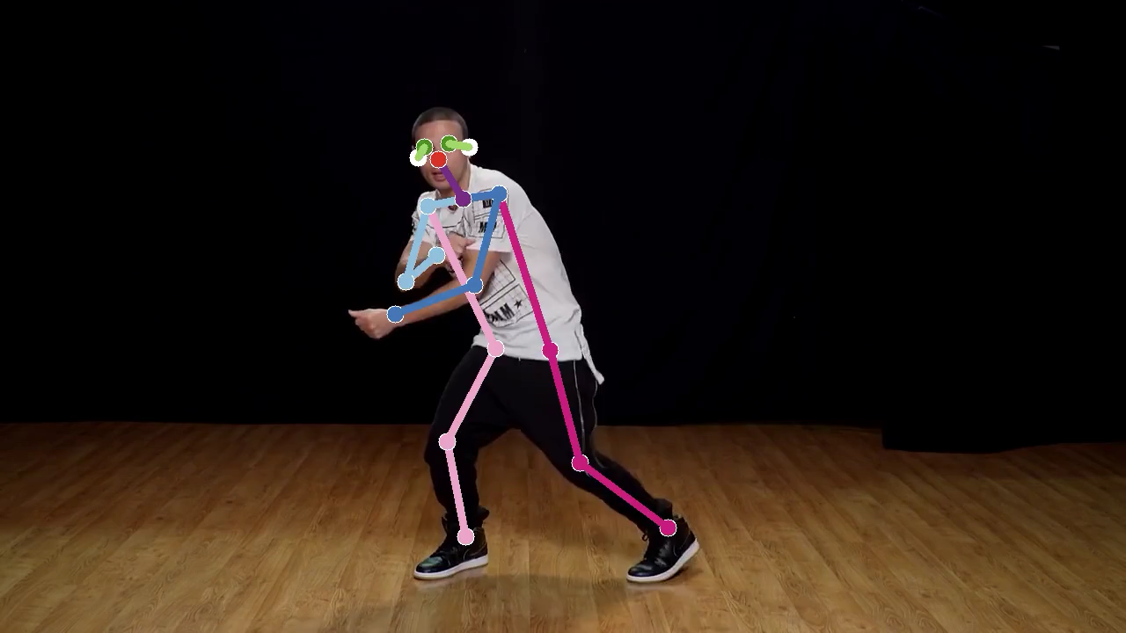
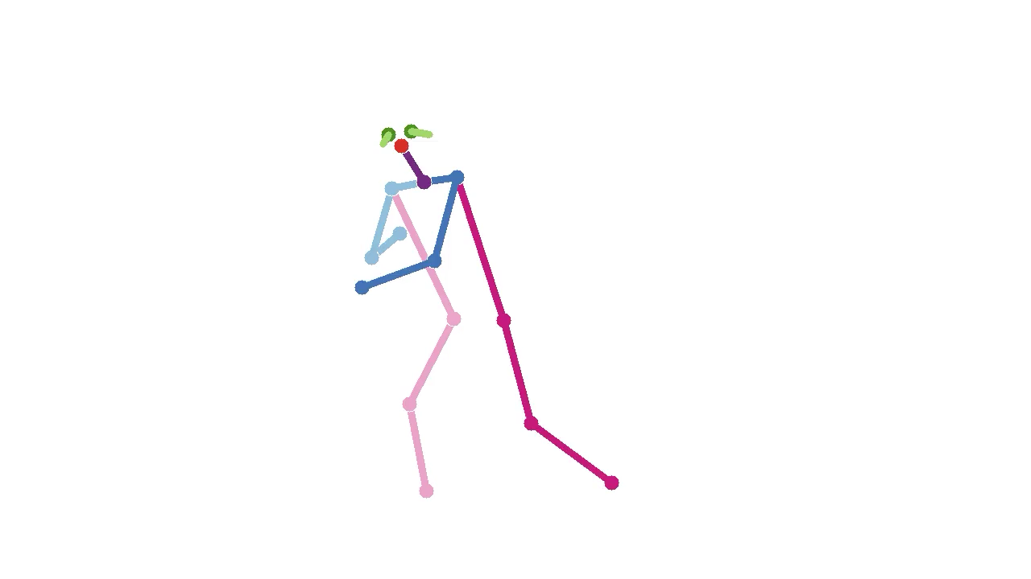
Ground Contact Prediction – Input Representation
Our approach:
Use 2D pose estimations as input
Notes:
Instead, we use 2D pose estimation results as input.

Slide 16
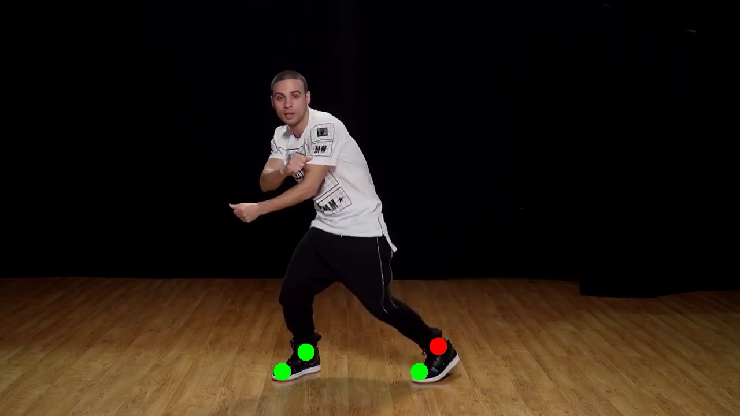
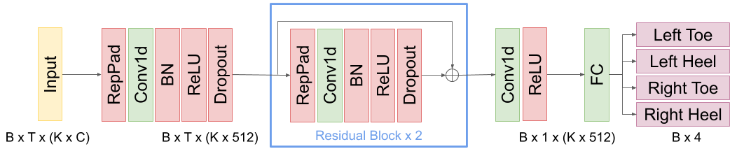
Ground Contact Prediction – Model
Input
Temporal Convolutional Net
Output
Notes:
We predict the ground contact events using a temporal convolutional network.

Slide 17
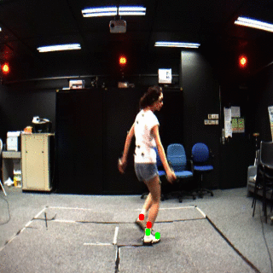
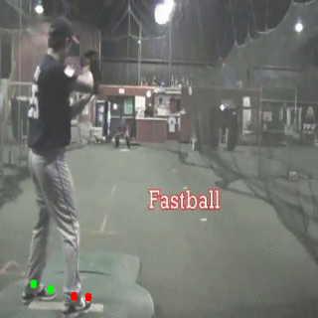
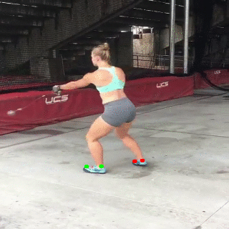
Ground Contact Prediction – Results
in contact
not in contact
Notes:
Here are some predicted results from our model.
We can see that it generates reasonable predictions for both indoor and outdoor scenes.

Slide 18
Step 1: Ground Contact Prediction
Notes:
So that’s the first step.

Slide 19
Step 2: Motion Reconstruction
Notes:
Next, we are going to talk about motion reconstruction

Slide 20
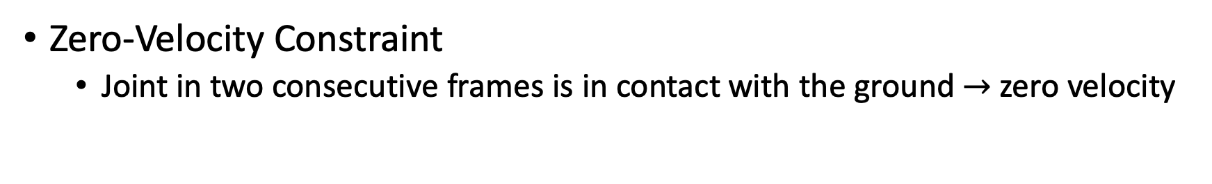
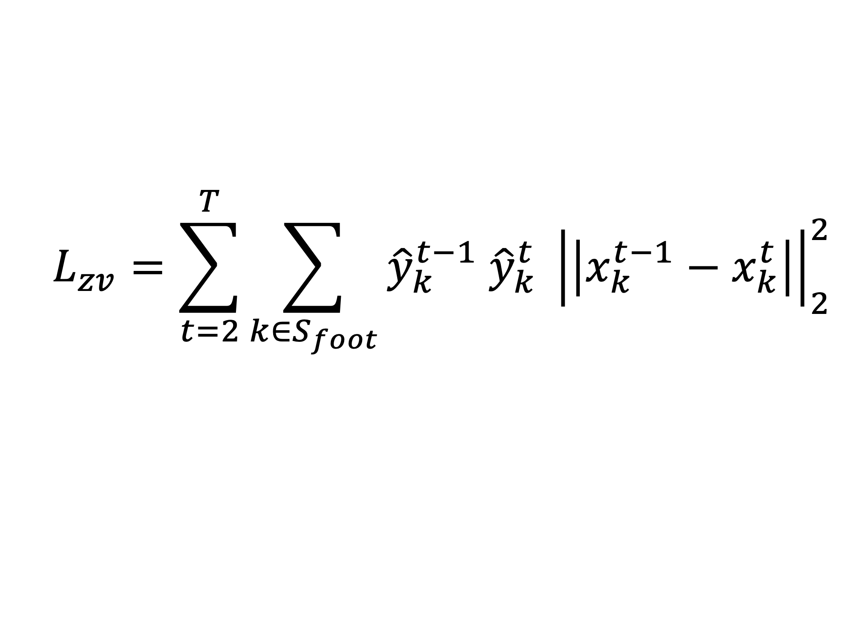
Motion Reconstruction
Zero-Velocity Constraint
Joint in two consecutive frames is in contact with the ground $→$ zero velocity
$$L_{zv}=\sum_{t=2}^{T}{\sum_{k∈S_{foot}}{{\hat{y}}_{k}^{t−1} {\hat{y}}_{k}^{t} {\left|\left|x_{k}^{t−1}−x_{k}^{t}\right|\right|}_{2}^{2}}}$$
Ground contact prediction
Global coordinates
Notes:
Once we have the ground contact predictions, we can use it for the zero-velocity constraint.

Slide 21

Motion Reconstruction – Two-Stage Optimization
First stage: HMR + temporal smoothing
(SFV [Peng et al. 2018]) $→$ a good initialization
Notes:
we adopt a two-stage optimization strategy.
First, we apply SFV to get a good initialization

Slide 22

Motion Reconstruction – Two-Stage Optimization
First stage: HMR + temporal smoothing
(SFV [Peng et al. 2018]) $→$ a good initialization
Second stage: jointly optimizing zero-velocity and temporal consistency
Notes:
We then add our zero-velocity constraint and jointly optimize all the constraints in the second stage.

Slide 23
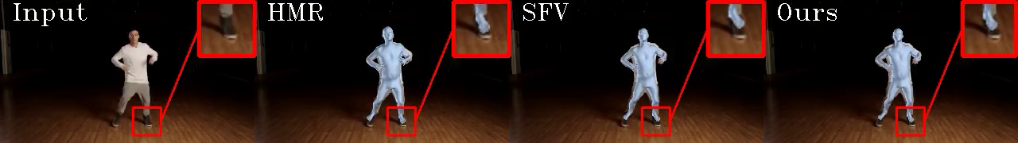
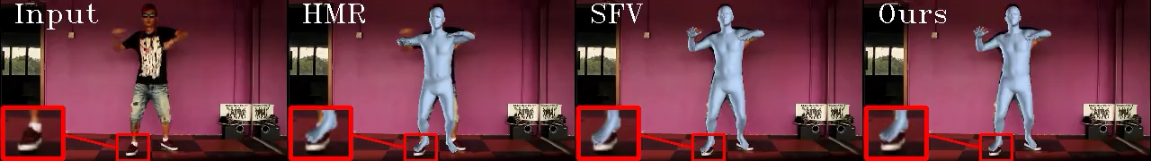
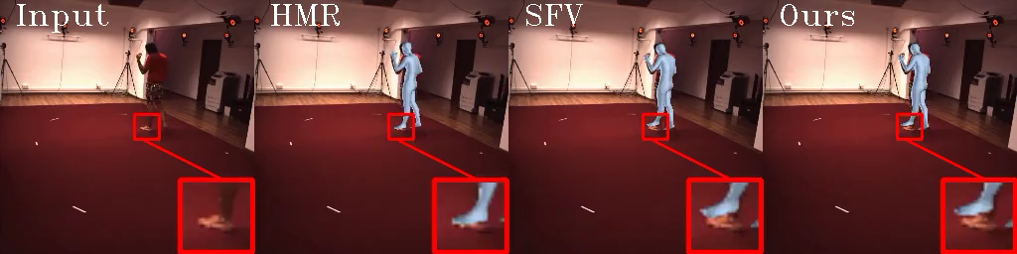
Motion Reconstruction – Results
Notes:
Here are some motion reconstruction results from our system.
#
For the zoom-in regions, we can see that the proposed method indeed mitigate the footskate artifacts.

Slide 24
Motion Reconstruction – Results
Notes:
Here are some motion reconstruction results from our system.
#
For the zoom-in regions, we can see that the proposed method indeed mitigate the footskate artifacts.

Slide 25
Motion Reconstruction – Results
Notes:
Here are some motion reconstruction results from our system.
#
For the zoom-in regions, we can see that the proposed method indeed mitigate the footskate artifacts.

Slide 26
Motion Reconstruction – Results
Notes:
Here are some motion reconstruction results from our system.
#
For the zoom-in regions, we can see that the proposed method indeed mitigate the footskate artifacts.

Slide 27


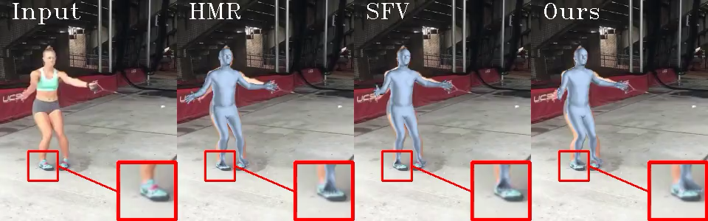
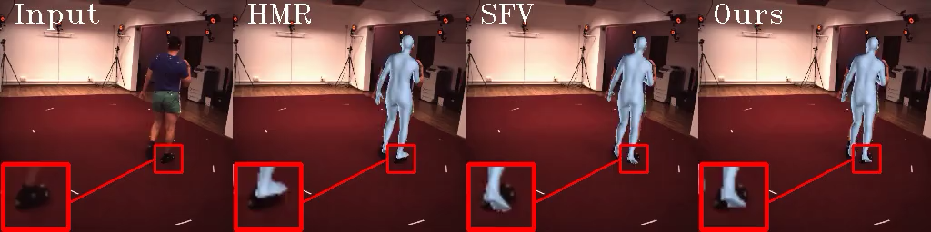
Project Page (code & data):
bit.ly/fs_reducer
Thank you!
Reducing Footskate in Human Motion Reconstruction
with Ground Contact Constraints
Notes:
Thank you for your attention.

